Slide 1
State Reporting Overview for Administrators
Copyright © 2017, FCMAT/California School Information Services

Slide 2
Agenda
CALPADS
Data Collections
How Data Are Used
Data Indicators Used
DATA MANAGEMENT
RUSD Key Roles
Resources and Support
Data Management

Slide 3
CALPADS
California Longitudinal Pupil Achievement Data System
CALPADS
http://www.cde.ca.gov/ds/sp/cl/
Data collected throughout the school year as students enroll and exit
  Student enrollment, demographic, program eligibility and participation, course enrollment and completion, discipline
  Statewide assessment data
  Certificated staff demographics and assignments
Statewide data systems matches
Specific data collections

Slide 4



CALPADS – Which Students Are Included?
Private School
Public, K-12, Ungraded
Pre-K Special Ed. Students (optional for general ed.)
Adult Education
Statewide Student Identifier
NPS, K-12, Ungraded
Pre-Kinder
Graduation
Collects longitudinal data about students from first enrollment to exit

Slide 5




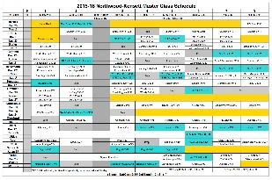

Local Data Sources
Student Information System
Registration/ Enrollment Forms
Teachers, administrators, programs, discipline
Nutrition Services
Course Information
Special Ed System
Human Resources
Attendance

Slide 6


CALPADS Data Sources
Student Information System
CA Dept of Social Services
CALPADS
CalFresh
CalWorks
CWS/CMS
Special Education Information System
SBAC

Slide 7



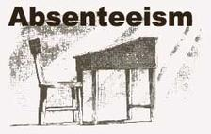







CALPADS – What data are collected and when?
Student Enrollments and Exits
Student Absenteeism
Student Demographics
END-OF-YEAR
FALL
Student Discipline
Student Program Eligibility and Participation
Student Career Technical Education
Student English Language Acquisition
Student Course Enrollment and Completion
Staff Data

Slide 8
CALPADS Data Reflect…
Current data (Operational Data Store – ODS)
  Ongoing longitudinal, frequent updates
  e.g. accountability subgroups
Certified data (Snapshot)
  Point in Time Data (reflecting census day)
  Date Range (based on defined reporting periods)

Slide 9

Current Un-Certified Data
ALL data in CALPADS can be updated anytime throughout the year
  Recommended, but not required
Data updated most frequently in CALPADS:
  Student Enrollments
  Student Demographics
  Student Subgroups

Slide 10
CALPADS Data Collections
Fall 1
As of census day
Fall 2
As of census day
Student Course Enrollments
2017–18 Enrollment Counts
EOY 3
July 1–June 30
Student Discipline/
Spec Ed
Course completion for grades 7–12
Immigrant Counts
2016–17 Grads and Drops
English Language Acquisition Status
Staff Assignments and FTE
English Learner Education Services
EOY 1
July 1–June 30
EOY 2
July 1–June 30
Program
Participation
CTE participants, concentrators, completers (Perkins Report)
Homeless Students
Student Absence Summary
Cumulative Enrollment
LCFF eligible students

Slide 11
CALPADS Snapshot Collection Windows
2017-18
Information Day
First Wed in Oct
Initial Deadline
Dec 15, 2017
Final Deadline
Jan 26, 2018
Fall 1
Submission Window |  |  | Amendment Window
Oct | Nov |  | Dec |  |  |  | Jan |  | Feb |  | Mar | Apr | May |  | Jun | Jul | Aug |  | Sep
 |  |  |  |  |  |  |  | Submission Window |  |  | Amend |  |  | Submission |  |  | Am
Fall 2 |  |  |  |  |  |  |  |  |  |  |  |  |  | End of Year
Snapshots Available
Dec 20, 2017
Initial Deadline
Feb 23, 2018
Start of Submission
May 14, 2018
Initial Deadline
Jul 31, 2018
Final Deadline
Aug 10, 2018
Final Deadline
Mar 23, 2018

Slide 12
Upcoming Changes
2017-18
Fall 1 | Golden State Seal Merit Diploma, Seal of Biliteracy and CTE Completer | Reported in Fall 2017-18
2017-18 and Beyond
 | CASEMIS Reporting Transition | Phase-in over multiple years
 | Perkins E2 Transition
 | View Only Role

Slide 13
How CALPADS Data are Used
State Agencies
(Data Matches)
LCFF and other Funding
Eligibility for state and federal grants
State and Federal Reporting
CALPADS
Statewide Assessments
CA School Dashboard
Research
LCAP Evaluation Rubrics
School Accountability Report Cards
Ed-Data
DataQuest

Slide 14
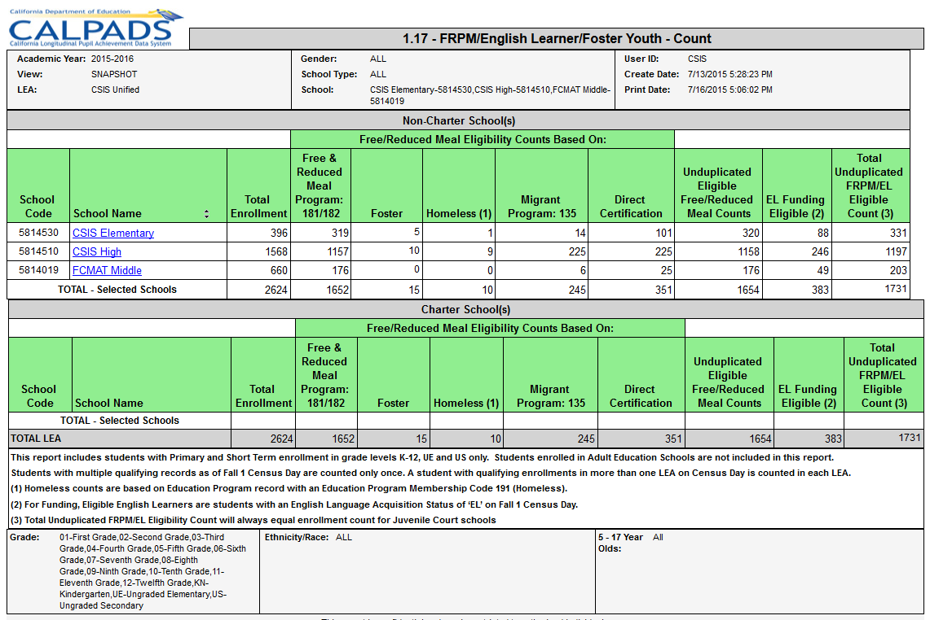
How Data are Used
Notes:
Supplemental funding count is determined based on:
Students qualifying for Free or Reduced Price Meals or
Being classified as English Learners or
Being identified as Foster Youth or
Does NOT include parent ed level 14 (but 1.1 does)
Includes FRPM & DC through 10/31/16
Students may qualify for consideration under multiple categories. The report provides Duplicated Counts (for those students qualified by multiple criteria) and Unduplicated Counts by school where a student is counted only 1 time per school. Counts students with Primary and Short Term enrollments in grade K-12. Adult Education not included.
Students with multiple qualifying records as of Fall 1 Census Day are counted only once in the LCFF funding calculation. A student with qualifying enrollments in more than one LEA on Census Day is counted in each LEA.
Homeless counts based on Home Dwelling codes of Temporary Shelters (100), Hotels/motels (110), Temporarily Doubled Up (120), or Temporarily Unsheltered (130)
²Foster Youth counts based on a weekly match of student records with California Dept. of Social Services (CDSS)
³ For Funding, Eligible English Learners are students with an English Language Acquisition Status of ‘EL’ on Fall 1 Census Day.
⁴FRPM/EL/Foster Youth Total will always equal enrollment count for Juvenile Court schools.
User must possess the Free and Reduced role in order to view/run this report.
LCFF – Local Control Funding Formula
- supplemental and concentrator funding based on kids being at
1 FRPM Eligible
2 - EL kids
We strongly advice LEAs to first look at report 1.1 and reconcile their enrollment counts and their EL counts then look at the aggregate counts on this report.

Slide 15
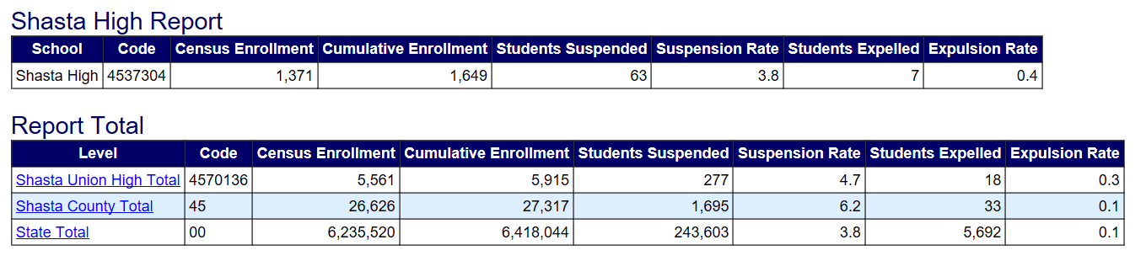
How Data are Used - Sample DataQuest Report
DataQuest Suspension and Expulsion Rates

Slide 16
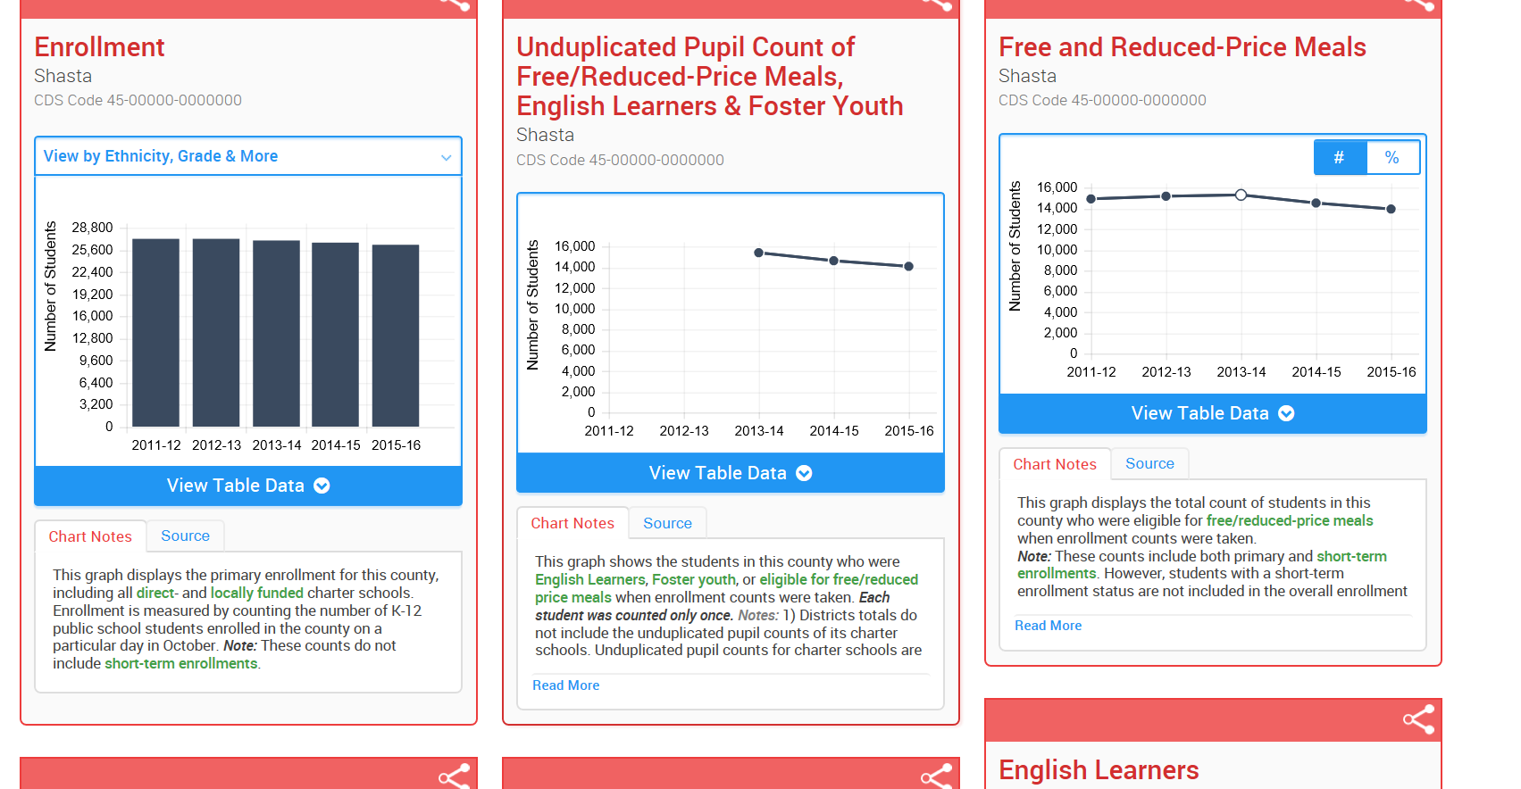
Sample Ed-Data Display

Slide 17
Data in the Spring 2017 Dashboard
Indicator | Data Used for Status | Data Used for Change
Suspension Rate | 2014–15 suspension rate | 2014–15 suspension rate minus 2013–14 suspension rate
English Learner Progress | 2015 and 2014 CELDT + 2014 reclassification data | 2015 and 2014 CELDT + 2014 reclassification data minus 2014 and 2013 CELDT + 2013 reclassification data
Graduation Rate | 2014–15 four–year cohort graduation rate (Class of 2015) | 2014–15 four–year cohort graduation rate minus Three–year weighted average (i.e., 2013–14, 2012–13, and 2011–12)
Academic: Grades 3–8 | 2016 Smarter Balanced Summative Assessments (ELA and mathematics) | 2016 Average Distance from Level 3 minus 2015 Average Distance from Level 3
College/Career (No performance level or color) | Graduates in the 2013–14 four–year graduation cohort (class of 2014) who are “Prepared”, “Approaching Prepared”, and “Not Prepared” on the CCI | Not Applicable
Grade 11 Distance from Level 3 (No performance level or color) | 2016 Smarter Balanced Summative Assessments (ELA and mathematics) | 2016 Average Distance from Level 3 minus 2015 Average Distance from Level 3
Source: California School Dashboard Technical Guide 2016-17 School Year

Slide 18
Data in the Fall 2017 Dashboard
Indicator | Data Used for Status | Data Used for Change
Suspension Rate | 2016–17 suspension rate | 2016–17 suspension rate minus 2015–16 suspension rate
English Learner Progress | 2017 and 2016 CELDT + 2016 reclassification data | 2017 and 2016 CELDT + 2016 reclassification data minus 2016 and 2015 CELDT + 2015 reclassification data
Graduation Rate | 2015–16 four–year cohort graduation rate (Class of 2016) | 2015–16 four–year cohort graduation rate minus Three–year weighted average (i.e., 2014–15, 2013–14, and 2012–13)
Academic: Grades 3–8 | 2016 Smarter Balanced Summative Assessments (ELA and mathematics) | 2017 Average Distance from Level 3 minus 2016 Average Distance from Level 3
College/Career (No performance level or color) | Graduates in the 2015–16 four–year graduation cohort (class of 2016) Reporting to be determined | Not Applicable
Grade 11 Distance from Level 3 (No performance level or color) | 2017 Smarter Balanced Summative Assessments (ELA and mathematics) | 2017 Average Distance from Level 3 minus 2016 Average Distance from Level 3
Source: California School Dashboard Technical Guide 2016-17 School Year

Slide 19
CALPADS Data Used in Indicators
Data Used From CALPADS | Suspension Rate | English Learner Progress | Graduation Rate | Academic: Grades 3 8 | College/ Career | Grade 11 Distance from Level 3
Enrollment | Yes | Yes | Yes | Yes | Yes | Yes
Exit Date |  | Yes | Yes | Yes | Yes | Yes
Discipline | Yes
School Completion (Graduated) |  |  | Yes |  | Yes
A-G Completion |  |  |  |  | Yes
Career Tech Education (CTE) Completion |  |  |  |  | Yes
Dual Enrollment |  |  |  |  | Yes
Race/Ethnicity | Yes |  | Yes | Yes | Yes | Yes
English Learner | Yes | Yes | Yes | Yes | Yes | Yes
Reclassified Fluent (RFEP) |  | Yes | Yes | Yes | Yes | Yes
English Learner Enrolled in a US School less than one year |  |  |  | Yes |  | Yes
Valid Disability Code | Yes |  | Yes | Yes | Yes | Yes
Direct Certification | Yes |  | Yes | Yes | Yes | Yes
Parent Education Level | Yes |  | Yes | Yes | Yes | Yes
Foster Youth (Fall 2017) | Yes |  | Yes | Yes | Yes | Yes
Homeless (Fall 2017) | Yes |  | Yes | Yes | Yes | Yes
Migrant | Yes |  | Yes | Yes | Yes | Yes
Free and Reduced | Yes |  | Yes | Yes | Yes | Yes
County-District-Residence Code |  |  |  | Yes |  | Yes
Source: California School Dashboard Technical Guide 2016-17 School Year

Slide 20
How Certified CALPADS Data are Used
Annual Submission | State or Federal | State/Federal Data Usage | LEA Impact if Not Certified
Fall 1 | State | DataQuest (Enrollment, Graduates, Dropouts, and SNOR) | 0 counts
 |  | School Accountability Report Card (SARC) | No SARC prepopulation
 |  | Department of Finance for LCFF Supplemental and Concentration funding and budget projections | 0 counts and impact on funding
 |  | CA School Dashboard | 0 counts
 |  | Quality Education Investment Act (QEIA) funding | 0 counts & 0 funding
 |  | To address requests from policy makers, researchers, and other entities | 0 counts

Slide 21
How Certified CALPADS Data are Used
Annual Submission | State or Federal | State/Federal Data Usage | LEA Impact if Not Certified
Fall 1 | Federal | Title I and Title II | 0 counts & 0 funding for COEs and Direct Funded Charter schools
 |  | NCLB Consolidated State Performance Report (CSPR) | 0 counts
 |  | NCLB Title III Limited English Proficiency Program | 0 counts & 0 funding
 |  | NCLB Title III Immigrant Program (SNOR) | 0 counts & 0 funding
 |  | Titles VI & IX reports for the Civil Rights Act of 1964 | 0 counts
 |  | Individuals with Disabilities Education Act (IDEA) | 0 counts
 |  | Various U.S. Department of Education (ED) organizational websites | 0 counts
 | State & Federal | Eligibility to apply for various state and federal grants (especially those based on counts of socioeconomically disadvantaged students) | 0 counts and ineligibility to apply for grants

Slide 22
How Certified CALPADS Data are Used
Annual Submission | State or Federal | State/Federal Data Usage | LEA Impact if Not Certified
Fall 2 | State | DataQuest (Teacher Counts, Course Enrollments and EL Services) | 0 counts
 |  | CCR Title V, Section 97 (certificated staff) | 0 counts
 |  | EL Services | 0 counts
 | Federal | NCLB Consolidated State Performance Report (CSPR) | 0 counts

Slide 23
How Certified CALPADS Data are Used
Annual Submission | State or Federal | State/Federal Data Usage | LEA Impact if Not Certified
EOY-1 | State | DataQuest (Course Completion & CTE) | 0 counts
 |  | CA School Dashboard (CCI) | 0 counts
 | Federal | Carl Perkins Program (CTE Participants, Concentrators and Completers) | 0 counts & grant eligibility
EOY-2 | State | DataQuest (Programs and Homeless) | 0 counts
 | Federal | Elementary and Secondary Education Act (ESEA) Title 1, Part A Neglected | 0 counts & grant eligibility
 |  | EDEN (Education Data Exchange Network) Reporting | 0 counts
 |  | NCLB Consolidated State Performance Report (CSPR) | 0 counts
EOY-3 | State | DataQuest (Discipline, Chronic Absenteeism) | 0 counts
 |  | CA School Dashboard (Chronic Absenteeism) | 0 counts
 | Federal | NCLB Consolidated State Performance Report (CSPR) | 0 counts
 |  | Individuals with Disabilities Education Act (IDEA) | 0 counts
 |  | NCLB Title IX - At Risk/Persistently Dangerous Schools | 0 counts
 |  | ESEA Title IV, Part A, Subpart 3, Section 4141 (e) - Firearm Offenses | 0 counts
 |  | Gun Free Schools Act Annual Survey | 0 counts

Slide 24
How CALPADS Data are Used
Annual Submission | State or Federal | State/Federal Data Usage | LEA Impact if Not Certified
Accountability | State | School Accountability Report Card (SARC) | Data are pulled from the ODS at announced times and used for these purposes
 | Federal | Calculating the four-year graduation cohort rate used in the Adequate Yearly Progress (AYP) accountability measure.
 |  | Determining which students were continuously enrolled at the school or local educational agency (LEA), and which student test scores to “roll back” from an alternative education program (AEP) to the original school or LEA.
 |  | Determining which students were enrolled in a U.S. school for five or more years for the purpose of calculating Annual Measurable Achievement Objectives (AMAOs).
Assessments | State | Registering students for the California Assessment of Student Performance and Progress (CAASPP)

Slide 25

Data Management

Slide 26
RUSD Key Roles
Superintendent
  Data privacy and security
  Report certification
  Data management leadership
LEA Administrator
  Assign accounts and roles
  Train users
  Provide support
  Ensure data privacy and confidentiality
  Data submission
  Troubleshooting
  Data accuracy and report verification
  Coordination and collaboration
Stakeholders (District/Site)
  Enrollment, attendance, course data
  Discipline
  Report verification
  Data accuracy and report verification
  Coordination and collaboration

Slide 27
Privacy and Confidentiality Responsibilities
LEA Administrator
  Comply with state and federal privacy laws to protect the confidentiality of data stored in and/or retrieved from CALPADS
  Assigning and maintaining local user access privileges and accounts
    Insure local users understand their responsibilities with regards to security and privacy protections prior to assigning accounts and monitoring for compliance
    Annual audit of user accounts
Superintendent
  Establish local security policies and procedures with regard to personnel changes
  Assume responsibility and accountability for the actions of the LEA CALPADS Administrator and local CALPADS users

Slide 28
Data Management
Planning and Preparation
Data Reporting Calendar
Communications
Roles and Responsibilities
CALPADS Accounts and Roles
Data Collection
Enrollment
Programs
English Language
Course Enrollments
A-G
CTE
Services to ELs
Staff Information
Demo
Assignments
Courses
Data Updates and Submission
SSID Maintenance
Validations
Data Issues
SIS Process
New/changed requirements
Training
Data in system other than SIS
Timely feedback from program/site staff
Data Quality
Incomplete
Late
Incorrect
Subject Matter Reviews
Certification
Errors
Certifiers
Decertification
Anomalies
Multiple Files
Warnings
Fatal Errors
Timelines
Review Process
Data Privacy and Security

Slide 29


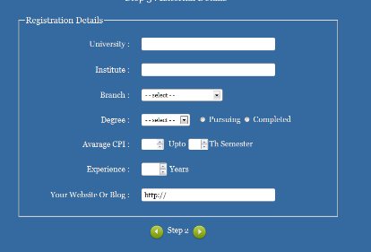



Successful Data Management Practices
Build a data management team
Build a data reporting calendar
Review source data forms
Perform periodic data audits
Invest in training/support tools
Provide annual reviews and updates

Slide 30



Putting it all together
Superintendent
Skills
Training
Backup
Other responsibilities
Competing priorities
Stakeholders
Skills
Training
Data Usage
Support
Consistent Practices
Support
LEA Administrator
Establish data security and privacy plan
Assume responsibility and accountability for the actions of the LEA Admin and local CALPADS users
Provide leadership for data
Identify and verify qualifications of the LEA Admin

Slide 31
Putting it all together
Data Stewards
Responsibilities established
Accountability
Planning
Cross-training
Coordination and cooperation
Data Coordinator
Specific data elements
Emergencies
SIS and other systems
Timely verification of reports
Ease of use
Audit capabilities
Systems synchronization
Support models
Alternative collection models
Third-party tools

Slide 32
Common Problems
Lack of support from administration
Conflicting priorities
Data coordinator not empowered within organization
  Apathy
Direct Certification data not shared with Nutrition Services staff
FRPM data not updated in SIS/CALPADS
Graduates completing A-G requirements not identified and reported
CTE completers
College level course enrollments
Homeless reporting

Slide 33
Key Points
CALPADS data are maintained for all K-12 students
  Data submitted throughout the school year
Accurate data are critical
  Used for funding, accountability, state and federal reporting requirements, assessments, research and more
Data coordinator key to successful reporting
  Professionalize role
Data must be kept secure and private
Organizational coordination and collaboration required
Support is available for LEAs
  Training, support desk, consulting

Slide 34
RUSD Resources and Support

Slide 35
Final Thoughts
Questions?
35
Notes:
35

